Slide 1
Autonomous Detection of Regular Languages
Joel Sommer, Lingjing Huang

Slide 2
Objective:
The objective of this project is to determine whether or not a neural network trained on strings that are in a regular language is able to determine if a string is in said language. Ideally, the neural network would be capable of analyzing an arbitrarily long string.

Slide 3
Performance Requirements:
In general, performance will be evaluated by using the Receiver Operating Characteristics ROC curve of the neural network’s after being exposed to varying quantities and types of training data and test data.

Slide 4
Source Software:
Libraries: TensorFlow.
Programming Language: Python.

Slide 5
Experimental Plan:
The project plan is to have at least 2 parts, train a language model on input dataset and assess performance of the model against a test dataset.
Use LSTM Networks Model. Long Short Term Memory are a special kind of RNN, capable of learning long-term dependencies.
Data input: At least 500 valid strings and 500 invalid strings for the training. And then around 100+ entries for the test set.

Slide 6
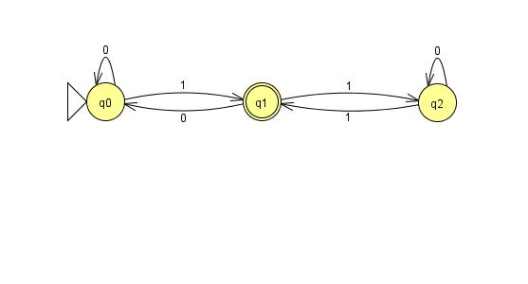
Datasets:
Multiple regular languages will be assessed during this experiment. For all of the languages, the same training and testing data sets will be used. This will allow for more reuse of the data sets.
The training set will contain x valid and y invalid sample string. Each test set will contain t valid and u invalid strings.

Slide 7
Proof of Concept:
The initial proof of concept will be to develop on form of RNN that can be trained to operate on the data set. If time permits, additional RNNs may be developed to evaluate the performance of different RNN types against the data set. After performing an initial proof of concept, the overall project plan may be altered to improve the direction of the project.

Slide 8
Final Deliverables:
The final report – a document, which will summarize our project’s idea, objective, progress, accomplishments and results.
Raw data – all samples (images) we generated and/or utilized in the project.
Presentation slides ­– brief overview of our project for the final in class presentation.
Webpage – Contain all information and source code about the project.

Slide 9
References:
[1] Tutorial of the Recurrent Neural Networks. https://www.tensorflow.org/tutorials/recurrent
[2] Understanding LSTM Networks. https://colah.github.io/posts/2015-08-Understanding-LSTMs/

